Slide 1


GNOME Desktop
Accessibility
Development & Testing
Sun Microsystems, Inc.
Aug 2010

Slide 2
Topics
What is accessibility?
Introduction to accessibility infrastructure
Current focus on accessibility development
How to test accessibility?
What are we testing on GNOME Desktop?
What can accessibility do for other testing?
How can I participate?
Comments and thoughts?

Slide 3
What is Accessibility
Accessibility is a technology enables individuals to make full use of computer-based technology despite variability in physical or sensory abilities due to illness, aging or disability.
The Accessibility Infrastructure gathers useful information about programs running on the desktop and provides this information to Assistive Technologies (ATs) which interact with end users.

Slide 4
What is Accessibility
Accessibility Infrastructure is useful for other purposes as well:
  Automatic Testing Tools: LDTP, Dogtail, Strongwind
  Alternative input/output devices
The GNOME Accessibility Infrastructure is based on the interfaces designed by Sun for Java Accessibility, and has been primarily driven and designed by Sun engineers.

Slide 5
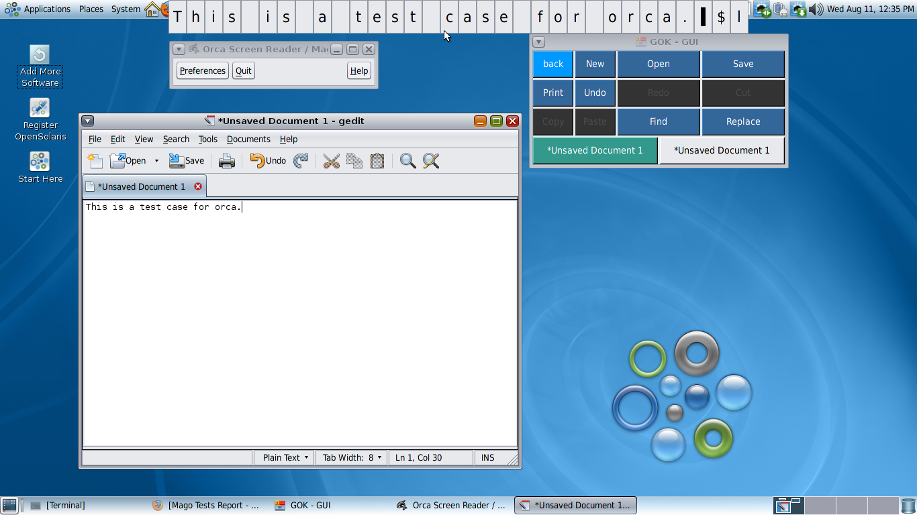
What is Accessibility
Orca
GOK
Assistive
Technology
Application

Slide 6
Applications and ATs communicate via a layered architecture
Application
Application changes trigger events which are dispatched through the layers.
ATs may make AT-SPI calls which are based on the application’s data, GUI, and/or internal state.
ATs “know about” the application by receiving events and issuing queries and requests.
Bridge
EVENTS
API calls
AT-SPI Layer
AT

Slide 7
Accessibility Infrastructure: Multiple ATK Impl.
Mozilla (Gecko)
GNOME apps
(GTK+)
Java apps
OpenOffice.org
......
Accessibility Gecko
GAIL
Java ATK Wrapper
UAA
......
Apps
ATK
atk-bridge
Application
events
Query
the current
user context
Obtain
app
content
Interact
with
UI
AT-SPI
AT
AT
Speak
text
Braille
I/O
Move
mag
region
AT SERVICES
Text to Speech
driver
Magnifier Service
BrlTTY driver

Slide 8
How GTK+/GNOME Apps connect to AT-SPI
APP
Bridge
AT-SPI
AT
GTK+/GNOME Application
ATK
GTK+
GAIL
ATK Bridge (libatk-bridge)
GNOME applications implement an in-process accessibility API called ATK, which is ‘bridged’ to the common AT-SPI layer by the ATK-bridge module.
GAIL hooks into ATK and implements ATK interfaces on behalf of GTK+. GAIL is dynamically loaded via glib’s GModule API.

Slide 9
Process space diagram
Application
ATK
GTK+
Bridge
Register App
at-spi-registryd
AT-SPI calls
List
apps
AT
AT gets app handles from registry, and registers for event notifications.
Other AT communications go direct to the application’s bridge code.

Slide 10
Current Focus
Starting with GNOME 3.0, the usage of CORBA (Bonobo,ORBit2) by the GNOME accessibility infrastructure will be deprecated.
D-Bus will become the default IPC mechanism.
This make it possible for the KDE and Qt community to start taking advantage of the accessibility infrastructure.
Sun engineers are working on re-write of the infrastructure to use D-Bus instead of CORBA.

Slide 11
Infrastructure: CORBA
GTK+
Mozilla
OOo
Java
GAIL
nsAccessible
UNO
JAAPI
ATK
ATK
ATK
JABG
atk-bridge
atk-bridge
atk-bridge
CORBA
pyatspi
at-spi-registryd
cspi
Orca
GOK
gnome-session

Slide 12
Infrastructure: D-Bus
GTK+
Mozilla
OOo
Java
GAIL
nsAccessible
UNO
JAAPI
JAW
ATK
ATK
ATK
ATK
atk-adaptor
atk-adaptor
atk-adaptor
atk-adaptor
D-Bus
at-spi2-registryd
pyatspi2
cspi2
Orca
GOK
D-Bus Activation

Slide 13
Java Apps use atk-bridge through wrapper
APP
Bridge
Java/Swing Application
AT-SPI
AT
Swing
javax.accessibility
Java ATK Wrapper for GNOME
ATK Bridge (libatk-bridge)
Swing defines a Java-specific accessibility API in javax.accessibility.
The Java ATK Wrapper is an implementation of ATK by using JNI technology. It converts Java Swing events into ATK events. Java ATK Wrapper replaces the former Java Access Bridge which sends events to AT-SPI layer directly.
Firefox and OpenOffice also use atk-bridge.

Slide 14
The new architecture
Application
ATK
GTK+
ATK-adaptor
Register App
at-spi2-registryd
AT-SPI2 events
AT-SPI2 calls
List
apps
AT
All IPCs are based on D-Bus.
New modules: at-spi2-core (including at-spi2-registryd), at-spi2-atk (including atk-adaptor), pyatspi2.

Slide 15
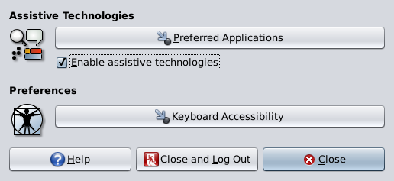
How to test accessibility
Make sure your accessibility switch turned on

Slide 16
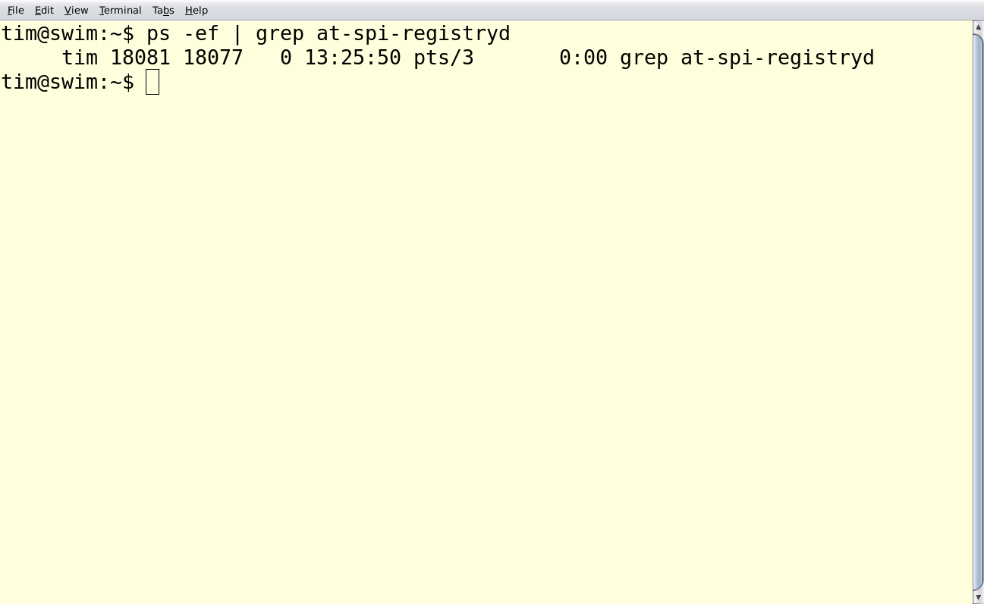
How to test accessibility
Make sure your accessibility switch turned on

Slide 17
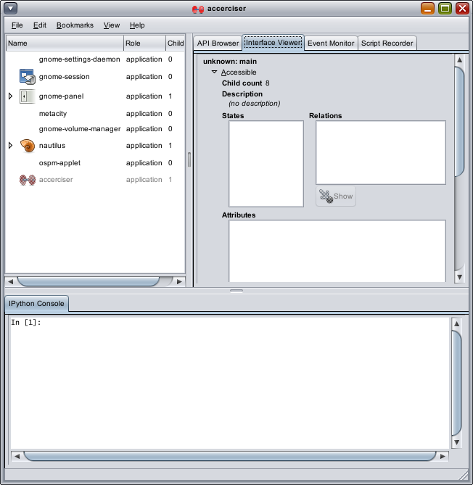
How to test accessibility
Accerciser - useful At-tool for testing & debugging

Slide 18
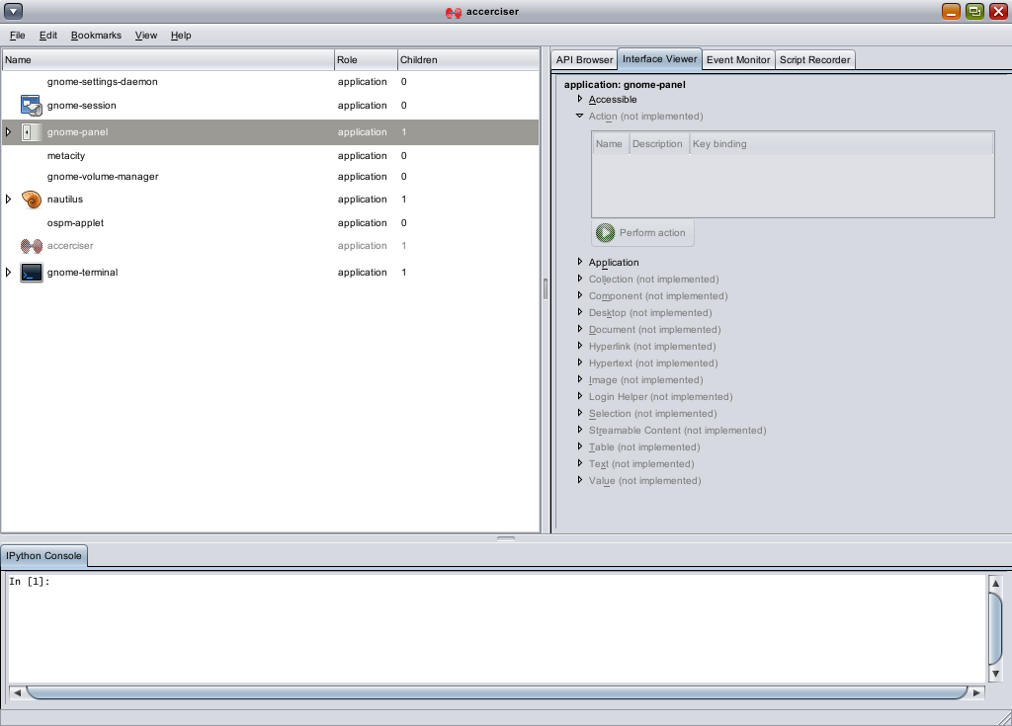
How to test accessibility
First thing to making an accessible app
  Your app should be “visible” to accerciser

Slide 19
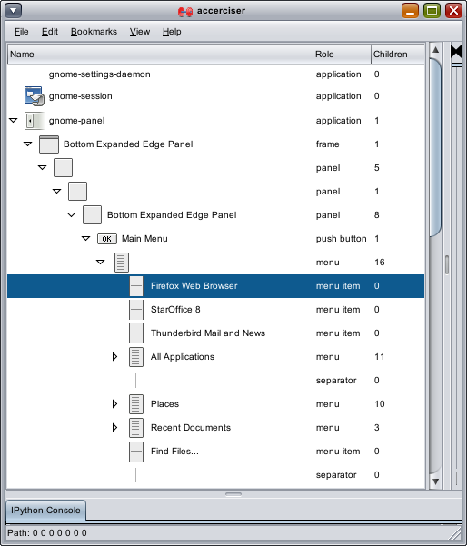
How to test accessibility
First thing to making an accessible app
  Each widget can be tracked down in accerciser

Slide 20
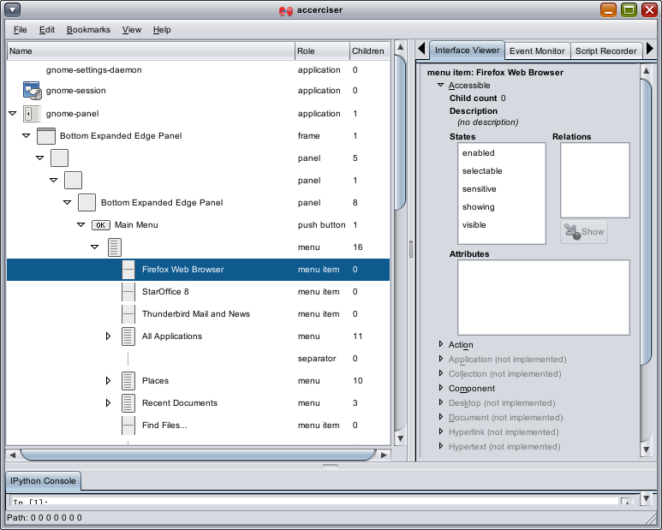
How to test accessibility
First thing to making an accessible app
  Check widget's accessibility status, relations, descriptions and attributes

Slide 21
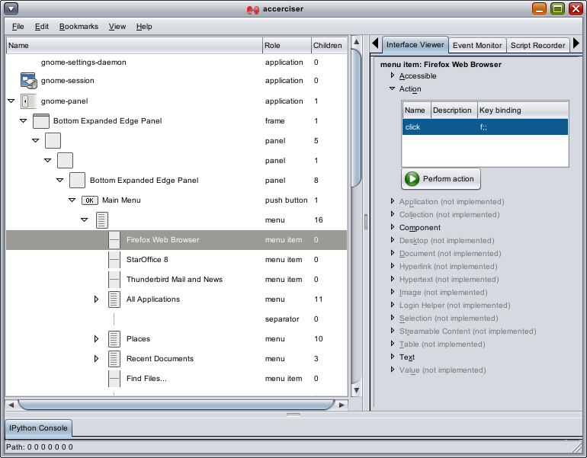
How to test accessibility
First thing to making an accessible app
  Action can be performed on widget

Slide 22
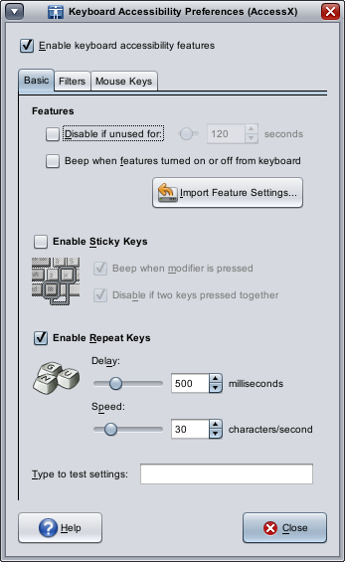
What are we testing on GNOME Desktop
AccessX
  Stick Keys
  Repeat Keys

Slide 23
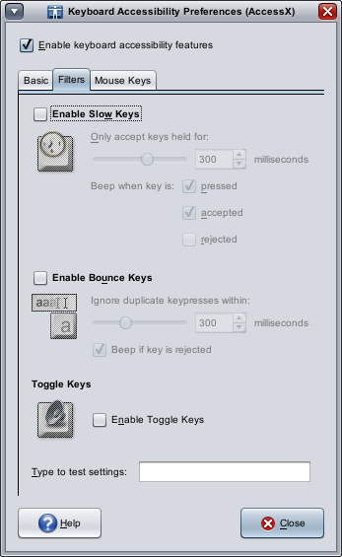
What are we testing on GNOME Desktop
AccessX
  Slow Keys
  Bounce Keys

Slide 24
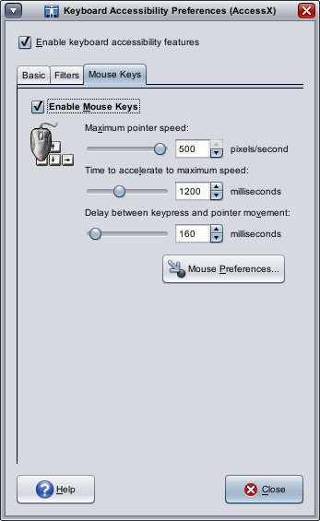
What are we testing on GNOME Desktop
AccessX
  Mouse Keys

Slide 25
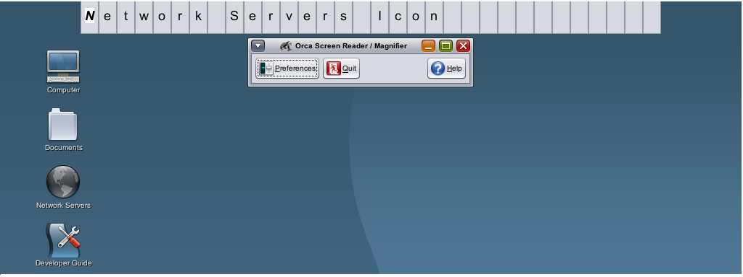
What are we testing on GNOME Desktop
Orca Screen Reader

Slide 26
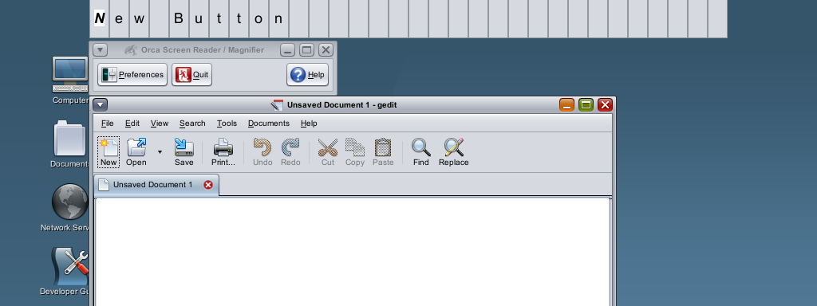
What are we testing on GNOME Desktop
Orca Screen Reader

Slide 27
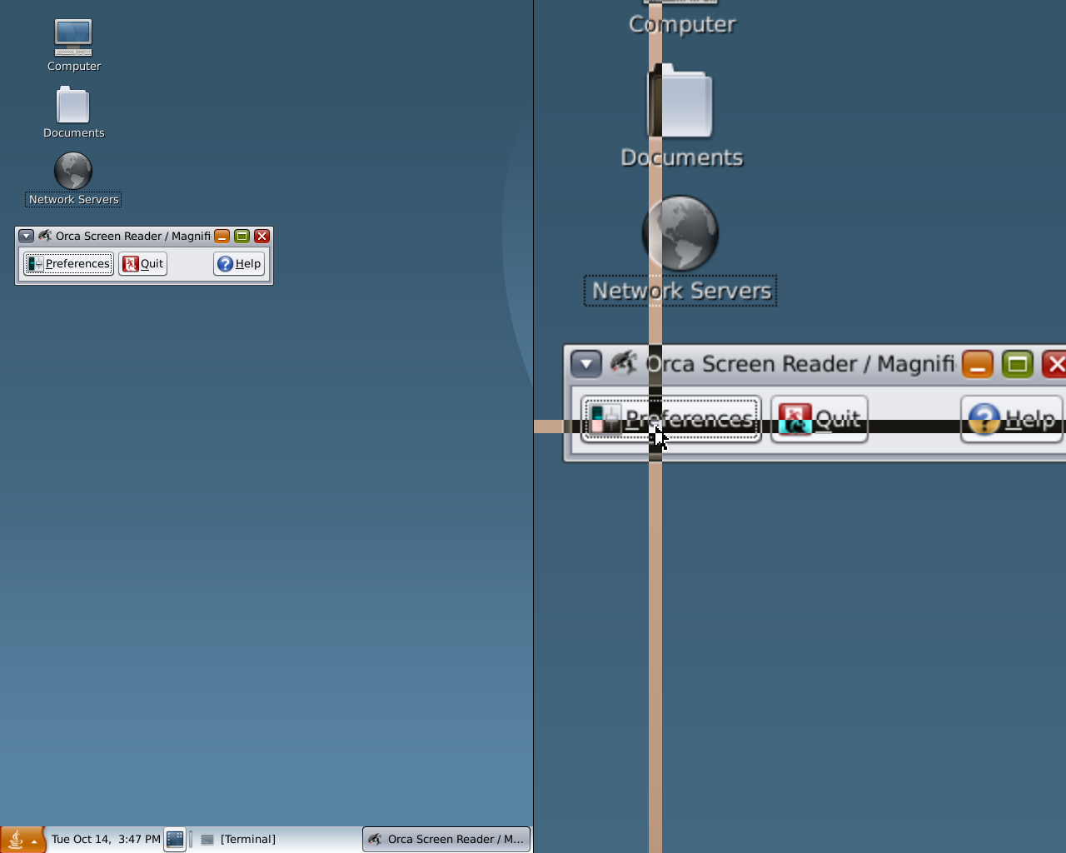
What are we testing on GNOME Desktop
Orca Screen Magnifier

Slide 28
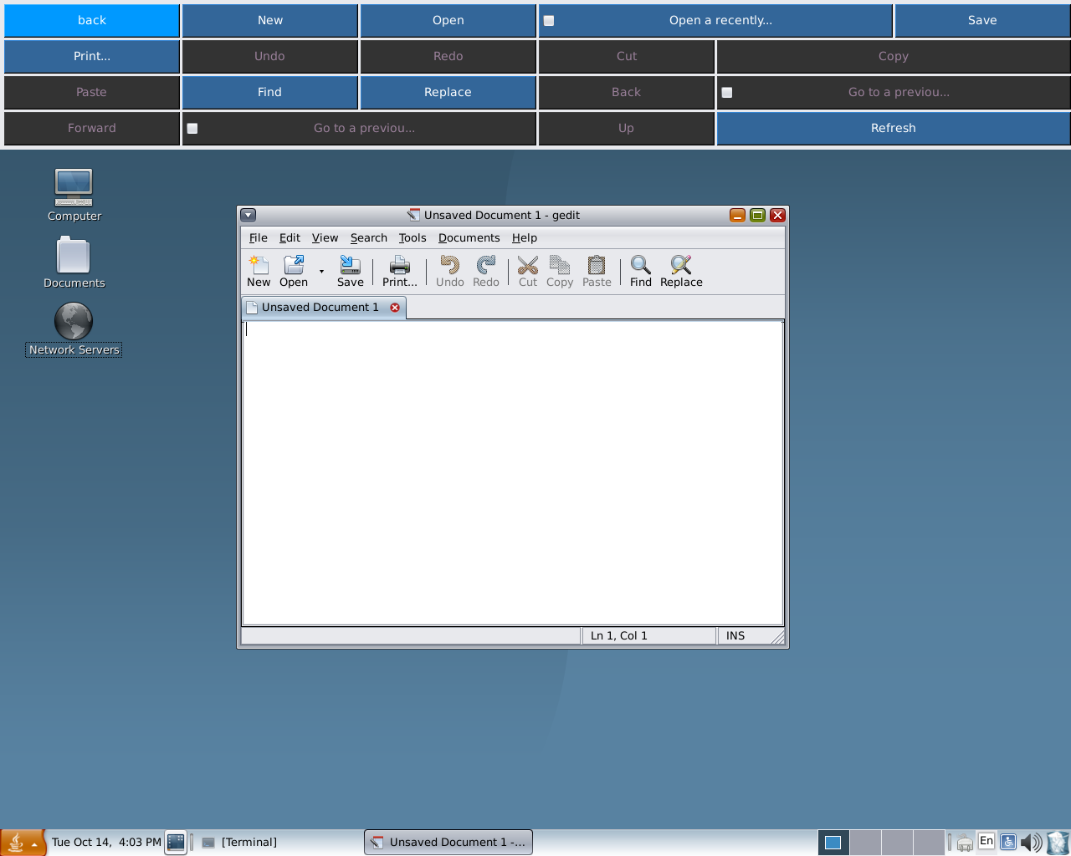
What are we testing on GNOME Desktop
GNOME On-screen Keyboard
  Switch device
  Pointing device
  Dwell device

Slide 29
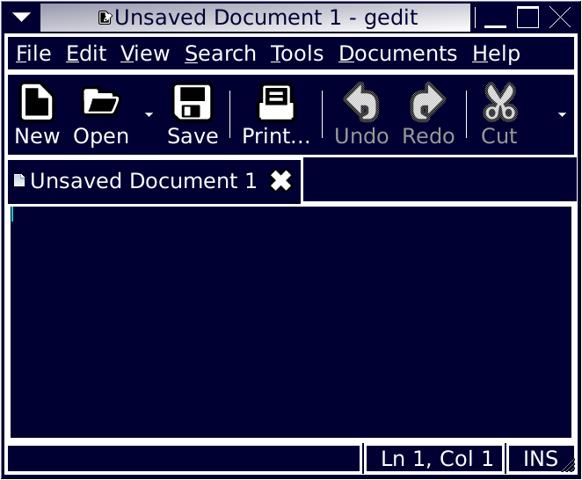
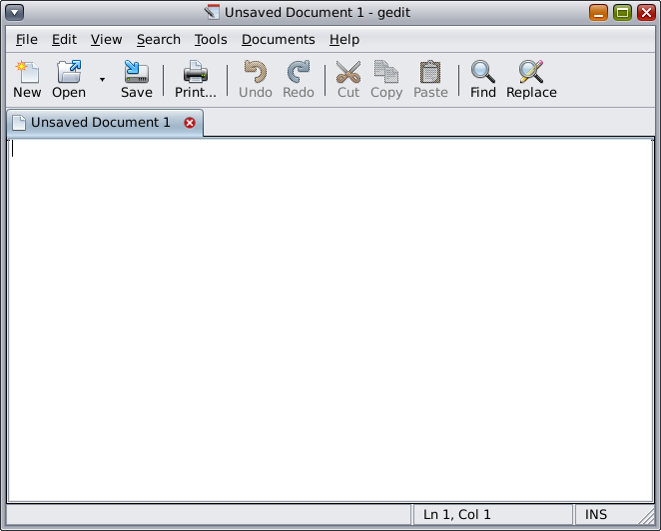
What are we testing on GNOME Desktop
GNOME Accessibility Themes
  HighContrastLargePrintInverse Theme

Slide 30
What are we testing on GNOME Desktop
Assess project accessibility status
Submit 508 Assessment for desktop projects
Over 20 projects meet the U.S. Gov 508 requirements, which include all kinds of desktop project, like browser, mail client, file manager and etc.

Slide 31
What can accessibility do for other testing
Automated functional testing
Accessibility testing
Automation testing tools:
  Dogtail
  Orca
  LDTP
  Strongwind

Slide 32
What can accessibility do for other testing
Automated functional testing
  There are a series of automated testing running on OpenSolaris desktop nightly build testing machines, cases are created for Dogtail test framework
  We also have more than 20 test cases for accessibility regression testing, cases are created for orca harness test framework

Slide 33
What can accessibility do for other testing
Automated functional testing
  GNOME Desktop Testing Project
    Mago/LDTP automation testing framework
    18 automation test cases created, more than 50 applications can be covered by automation testing
    Open community for developer, QA and contributors
    OpenSolaris branch is under developing and ready for everyone

Slide 34
How can I participate
To join discuss on GNOME
  Subscribe to: Gnome-accessibility-list-request@gnome.org
  Irc channel:
    irc.gnome.org
    #a11y
To join discuss on OpenSolaris
  Subscribe to:
    desktop-testing@opensolaris.org

Slide 35
How can I participate
GNOME community
  http://www.gnome.org/
  http://bugzilla.gnome.org/
  http://live.gnome.org/DesktopTesting
OpenSolaris community
  http://www.opensolaris.org/
  http://defect.opensolaris.org/

Slide 36
Comments and thoughts
  Q & A

Slide 37
Thanks!

